Slide 1
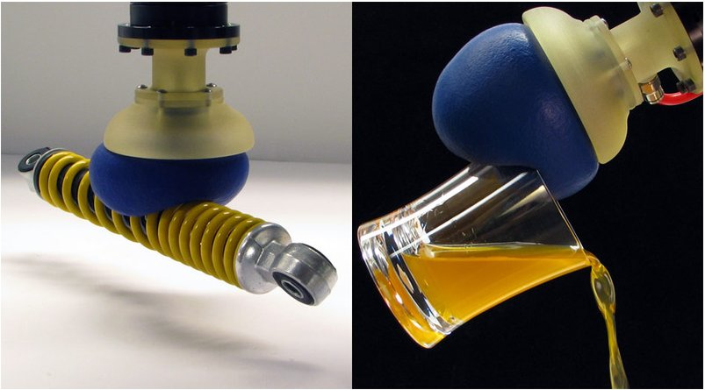
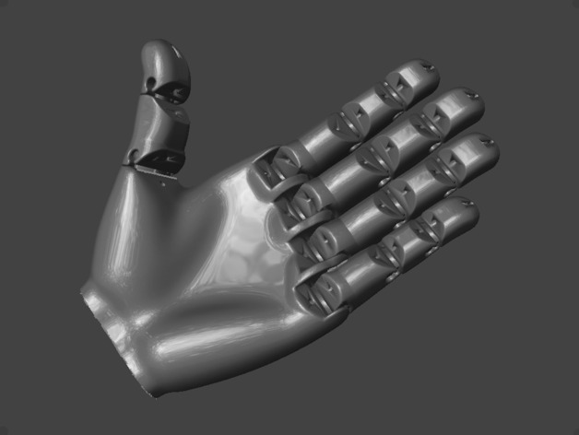
Soft Robotic Gripper using the jamming principle
Preliminary Design Review
http://www.hizook.com/files/users/3/Jamming_Robot_Hand_2.jpg
https://www.thingiverse.com/thing:242639

Slide 2
Key Points of the Soft Gripper
Uses the Jamming principle.
Multiple Joints for points of contact
Tendon control for actuation of the gripper
Vacuum Control

Slide 3
Jamming Principle Key points
Various different particles work in different ways
Due to Crystalline structures varying.
The size of the particles has an effect on how easy to form around the gripper and hence strength of the grip.
Due to the small sizes a vacuum is needed to form a strong vacuum.

Slide 4




Different Particle Considerations
Some of these considerations are found in Jamming of Soft Particles: Geometry, Mechanics, Scaling and Isostaticity (van Hecke, 2010)
There are a variety of different particles considered in building:
Salt(Size grades 1-4[Found on salt grinders])
Coffee
Chocolate Powder
Flour
Silica Gel
Vacuum Method.
Cotton as a clog
Cheese Cloth
Tissue paper

Slide 5
Design Considerations
How is the control of the multiple joints implemented.
How to control the Vacuum?
Gripper size considerations.

Slide 6
Prototyping
Design considerations:
Potentially using a central bone with balloon around the outside.
Using a flat surface with the balloon inside.
Critical Evaluation:
The design only focuses on open and closed.
Just a singular digit for now to show principle design.
No pressure sensor to halt the motion and activate the gripper vacuum(at this stage).

Slide 7
Preliminary Findings.
It was found that with low vacuum pressure, slightly larger particulate matter is better.
When using low vacuum pressure it is best to wrap the whole object
Cotton wool works sufficiently as a block
Re-arrangement of particles is useful but not necessary

Slide 8
Journals & Credits
van Hecke, M. . Jamming of Soft Particles: Geometry, Mechanics, Scaling and Isostaticity. Journal of physics. Condensed matter : an Institute of Physics journal. 22. 033101; DOI: 10.1088/0953-8984/22/3/033101.
Eric Brown, Nicholas Rodenberg, John Amend, Annan Mozeika, Erik Steltz, Mitchell R. Zakin, Hod Lipson, Heinrich M. Universal robotic gripper based on the jamming of granular material. Jaeger Proceedings of the National Academy of Sciences Nov 2010, 107 (44) 18809-18814; DOI: 10.1073/pnas.1003250107
Y. Li, Y. Chen, Y. Yang and Y. Wei, "Passive Particle Jamming and Its Stiffening of Soft Robotic Grippers," in IEEE Transactions on Robotics, vol. 33, no. 2, pp. 446-455, April 2017. doi: 10.1109/TRO.2016.2636899
http://www.physics.emory.edu/faculty/weeks/lab/papers/sendai2007.pdf

